Slide 1


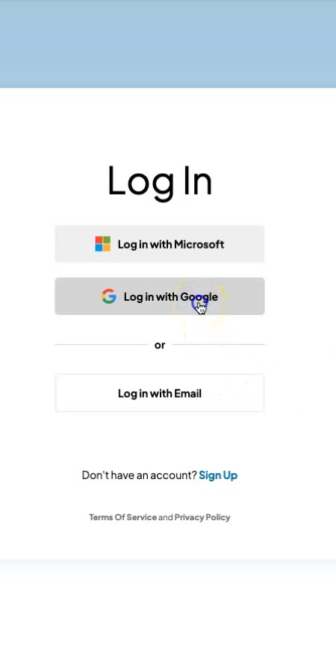
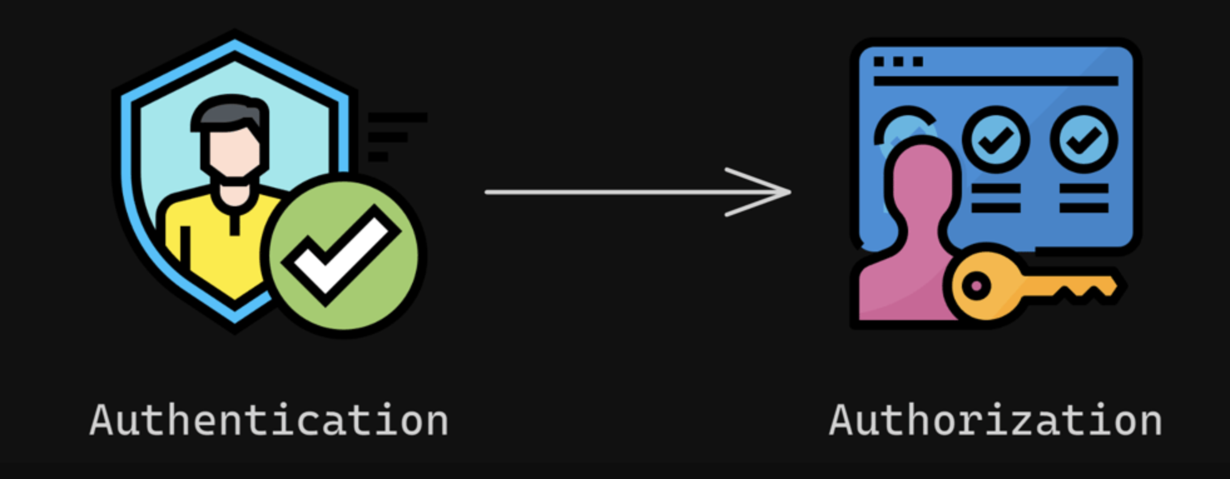


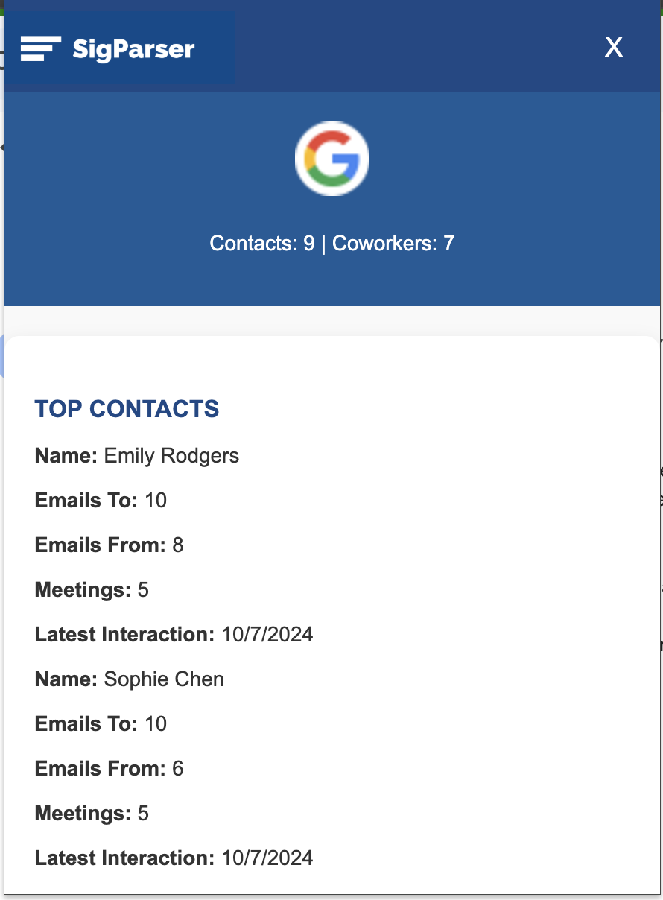
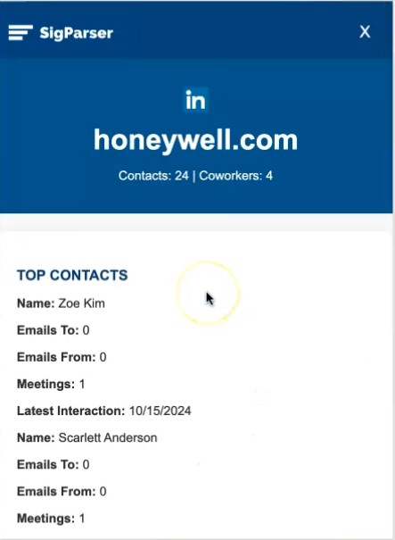
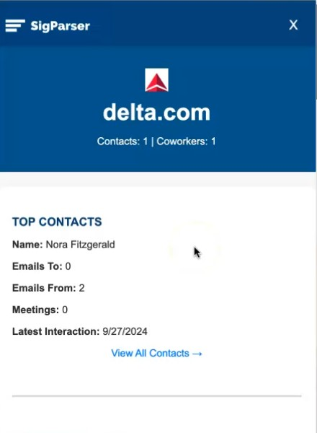



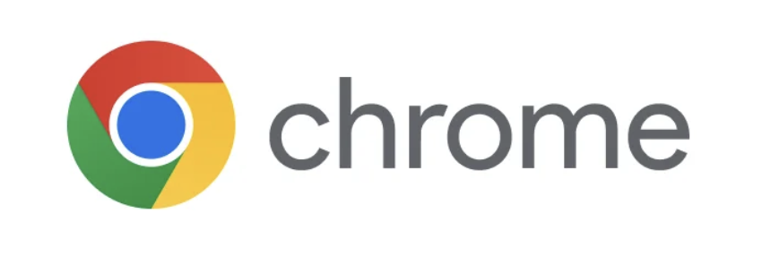
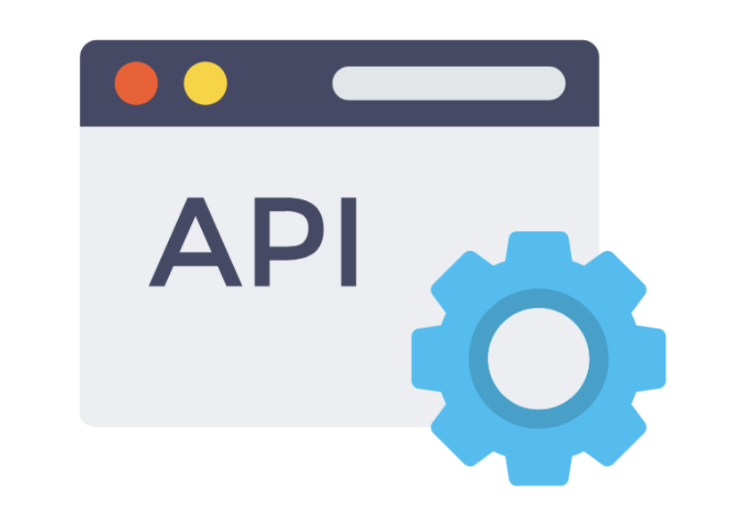
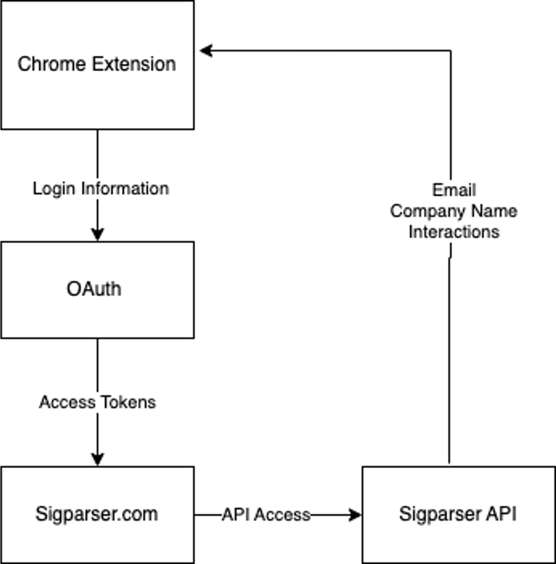
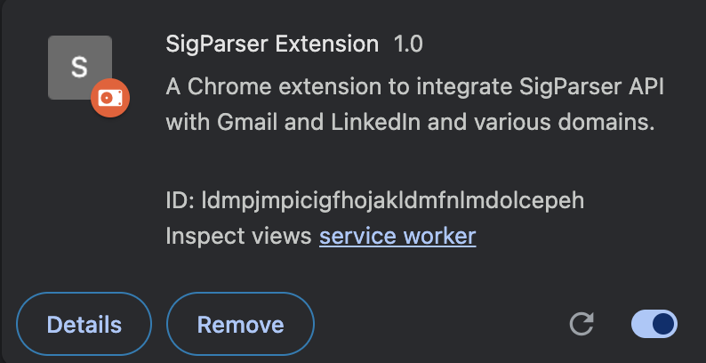
2024 CSUSM CS Capstone Project
Google Chrome Extension
Introduction
Abstract
Broader Impacts
In the digital age, businesses handle a massive influx of email communications, contacts, and relationship data. Understanding the connections between individuals and organizations can significantly enhance relationship management, improve customer interactions, and boost productivity.
SigParser provides an API that automatically extracts contact details and relational data from email signatures, allowing businesses to streamline data capture and organization. By leveraging SigParser’s capabilities, businesses can access valuable insights about their contacts, including roles, contact details, and interactions, directly from their email communications.
Student Team: Suphaphon Oi Mahawong, Ashley Kim, Denzel Corson, Epifanio Solano
Faculty Advisor: Jing Hou
Industry Mentor: Jessica Massey & Junior Yono
Sponsored By: SigParser
Large enterprise companies can benefit from the SigParser Extension. Marketing and Sales teams often depend heavily on relationship management data to track and strengthen their connections with potential clients. The visualizations provided by the SigParser extension of the communicational trends and interactivity in relationships will allow these large enterprises to prioritize their outreach efforts more effectively. Additionally, the extension reduces the manual effort in organizing contact data, leading to better time management and an increased focus on closing business meetings or deals.
This tool also cultivates collaboration across teams. Departments such as sales, marketing, and customer service will be able to access unified contact information, allowing consistent communication strategies across the organization.
The Google Chrome Extension provides a direct and efficient visualization identifying relationships between the user and a company’s employees or other additional individuals parsed within their mailbox. This extension will be displayed on company websites, Gmail, and LinkedIn.
The Chrome extension, built with HTML, CSS, and JavaScript, streamlines data extraction and display. JavaScript powers the logic, enabling real-time communication with the SigParser API and dynamic data updates without page reloads. HTML structures key relationship data, while CSS ensures visual clarity and responsiveness, using color coding to help users interpret information efficiently.
The Fetch API handles secure, dynamic network requests, authenticating with an API key and managing domain-specific data retrieval. Chrome's Extension API integrates with the browser, using features like Chrome.tabs.query() for active tab data and Chrome.runtime.sendMessage() for interfile communication. Permissions in the manifest.json file ensure secure access, creating a seamless user experience.
Architecture
The SigParser Extension was designed with a Client-Server Architecture
The Chrome Extension, the client, focuses on user interaction, like the current domain and email address the user is on to generate and display relevant information.
Security is provided by OAuth which ensures proper authentication to access SigParser API endpoint.
SigParser API is responsible for fetching and processing data, company and email interaction details, which are then presented to user through the Chrome Extension.
Architecture supports modular components, making it easy to integrate additional services and extend functionality.
Changes to individual components (UI or API) can be made without affecting other layers
Results
Third Party Software
The extension icon is a small but crucial visual element for any browser extension. It typically appears in the browser's toolbar, next to the address bar, and serves as the primary point of interaction for users.
Left: The OAuth page allows users to securely log in to the application using their credentials from third-party providers like Google or LinkedIn, ensuring seamless and secure authentication.
Left-Middle: The Gmail page enables users to scan their emails, retrieve contact information, and extract relevant company data using SigParser's integration.
Right-Middle: The LinkedIn page provides an interface to view and analyze connections, display relational data between contacts, and fetch enriched company information directly from LinkedIn profiles.
Right: The Domain page allows users to input a domain name and retrieve detailed company data, including insights and custom notifications, using the SigParser API
References
Browser extensions have a unique ID displayed in the extension manager (e.g., chrome://extensions) and used for API calls, messaging, and debugging. With Manifest V3, extensions use a service worker instead of background scripts to handle events like API calls and alarms. Service workers are event-driven, running only when needed and shutting down when idle to save resources, with their location specified in the manifest.json file under the background key. This setup ensures efficient performance and secure functionality.
React & TypeScript Chrome Extension Development [2024]
https://www.udemy.com/course/chrome-extension/?couponCode=24T4MT120424
Sig Parser website
https://sigparser.com/
Sig Parser IPAAS API
https://ipaas.sigparser.com/index.html
Chrome for Developers
https://developer.chrome.com/docs/extensions

